Slide 1

Primary Transit Network Economic Gap Analysis
Final Presentation
Calgary Transit (City of Calgary)
ECON 588/611
Winter 2024
${11}^{th}$April 2024

Slide 2



Our Team
Zach Grant
Suleman Basit
Nathanael Hammond
Nown Deng
Fahmid Kaisar
Partner Liaison
Report Writing
Programming Lead
Data Scraping
Research Lead
Data Visualization
Data Analyst
Data Cleaning
Report Writing
Data Visualization

Slide 3
Table of contents
01
02
03
04
05
06
Project Background
Methodology
Demand Index
Supply Index
Transit Gap Analysis
Way Forward

Slide 4
01
Project Background

Slide 5
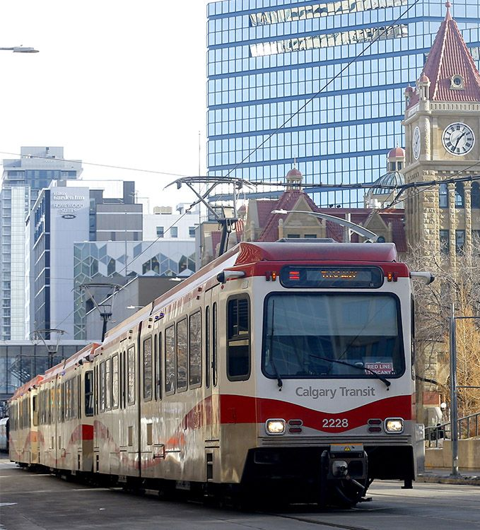
Calgary Transit
Calgary transit is looking to expand their primary transit network (PTN)
PTN includes both the c-train line and max bus routes
Calgary Transit has a limited budget, and wants guidance on where to spend it
Looking to improve access to more communities, including the north, especially near the airport, and the south-east.

Slide 6
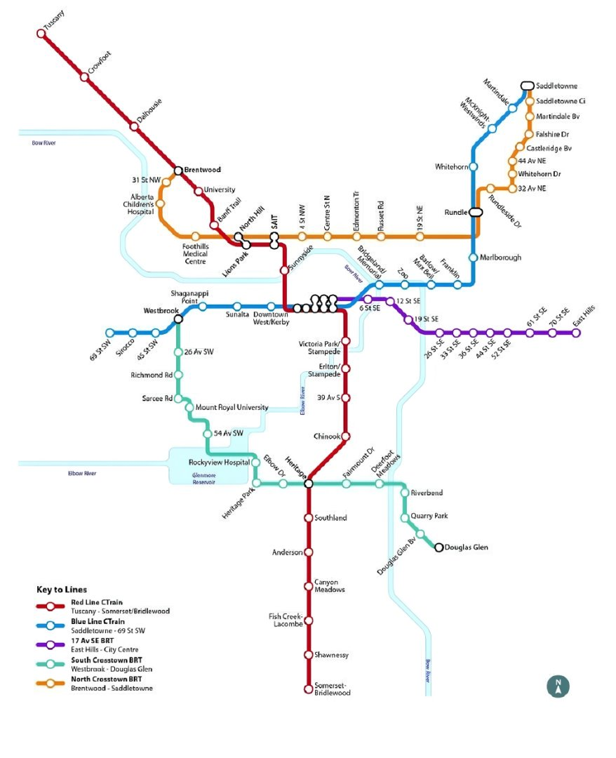
Calgary Primary Transit Network
82.5 Mn
Ridership in
2023
$1.87 per trip
Average Fare as of 2022
1,100
Active Vehicles as of 2022
62.2% CAGR
of trips from 2021 - 2023

Slide 7
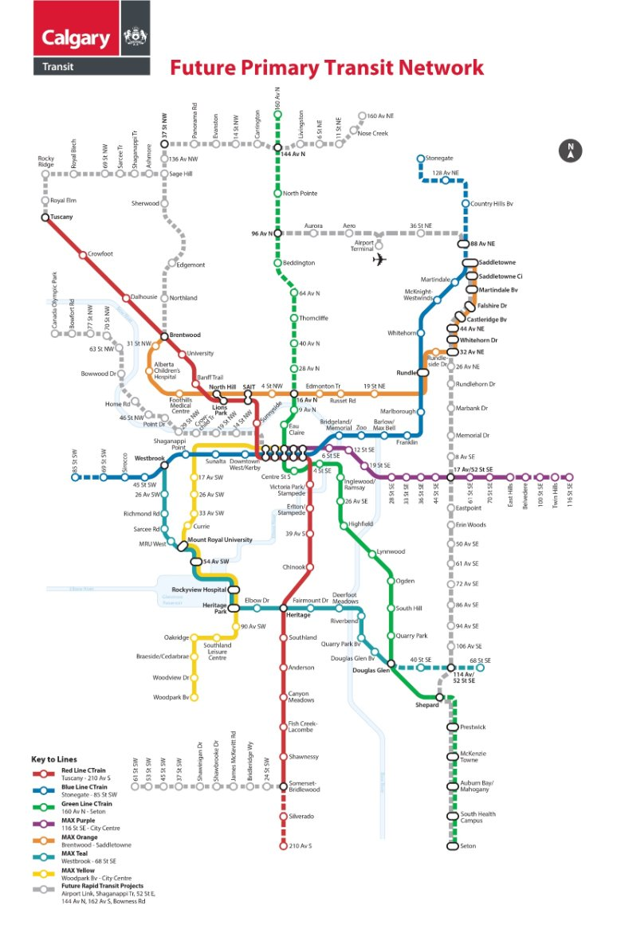
Calgary Future Primary Transit Network
Establishment of new Green C-Train line and Grey routes
Expansion of Red and Blue C-Train lines
Improved access to transit network for North and South-East communities

Slide 8
Project Objective
Demand
Supply
Identify where demand for transit is highest, and develop an index that accurately reflects the transit needs of each community.
Use demand index in analysis of transit gap
Understand where primary transit supply currently exists and where it is planned.
Evaluate supply by community and give supply an index for each community
Transit Needs Gap
Data Visualization
Compare transit demand and supply gaps for each community both in the current and future primary transit network.
Give each community a letter grade from A to F with F meaning highest transit demand-supply gap, and A meaning low transit demand-supply gap.
Interpret the data from the transit needs gap analysis and visualize it using ARC GIS and other data visualization techniques.

Slide 9
02
Methodology

Slide 10
Needs-Gap Analysis
Our methodology creates two measures:
A measure for need associated with transport disadvantaged people for each of the communities. This identifies people who have significant need for transit services, i.e. demand.
A measure for transit accessibility which will measure coverage and service and other important features of transit system, i.e. supply.
The transit gap for each community, will then be the difference between these two measures.

Slide 11
Supply Index: Local Index of Transit Availability (LITA)
For the supply index, we will follow a modified Rood's (1998) Local Index of Transit Availability (LITA).
This index has several components in its determination including service coverage, service frequency, and service capacity.
Service coverage is determined by the amount of primary transit stops within a community divided by the size of the community.
Service frequency is determined using the total number of times transit buses arrive in a community during peak hours.
Capacity is measured with the total primary transit seats available to a community for the day and divided by the population of the community.

Slide 12
Supply Index: Local Index of Transit Availability (LITA)
Service Coverage – a buffer zone of 400m and 800m is generated around bus stops and train stops respectively. Thus, if a community lies in the buffer zone, it is assumed to be served by the bus stop. The limitation is that: everyone in the community can access the bus or train stop, no matter where they are located in the community.
Service Frequency – how often a vehicle arrives at a stop (on average); how long one has to wait between trips.
Service Capacity – 65 seats was used for the Max buses and 600 for the LRT.

Slide 13
Demand Index: Transit Disadvantaged
For transit disadvantaged groups, we focus on the following due to data limitations:
Low-income persons with annual income less than CAD 26,503
Seniors aged 65 and above
Households who spend more than 30% on rent
Employed people who use transit

Slide 14
03
Demand Index

Slide 15
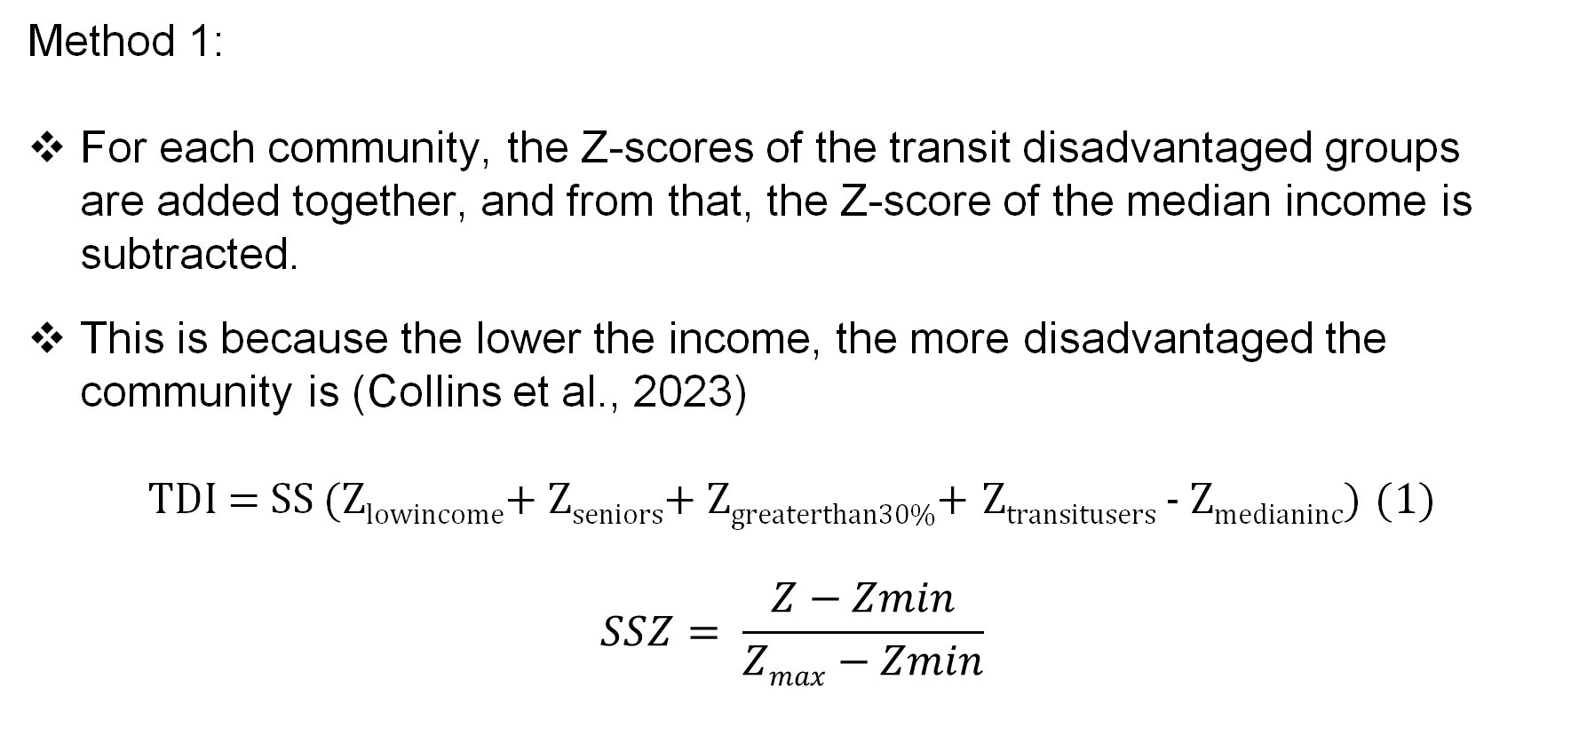
Demand Index: Calculation (Method 1)
Method 1:
For each community, the Z-scores of the transit disadvantaged groups are added together, and from that, the Z-score of the median income is subtracted.
This is because the lower the income, the more disadvantaged the community is (Collins et al., 2023)
TDI = SS (Z_{lowincome}+ Z_{seniors}+ Z_{greaterthan30%}+ Z_{transitusers} - Z_{medianinc}) (1)
$$SSZ= \frac{Z−Zmin}{Zmax−Zmin}$$

Slide 16
Demand Index Table (Method 1)
Community | Demand Index | Letter Grade Score
Eagle Ridge | 0.0000 | F
Mayfair | 0.0601 | F
Bayview | 0.0769 | F
Bel-Aire | 0.0800 | F
Scarboro | 0.0941 | F
Huntington Hills | 0.4628 | A
Panorama Hills | 0.4673 | A
Saddle Ridge | 0.4766 | A
Downtown Commercial Core | 0.6064 | A
Beltline | 1.0000 | A
The 200 communities are split into 5 quantiles and assigned letter grades accordingly

Slide 17
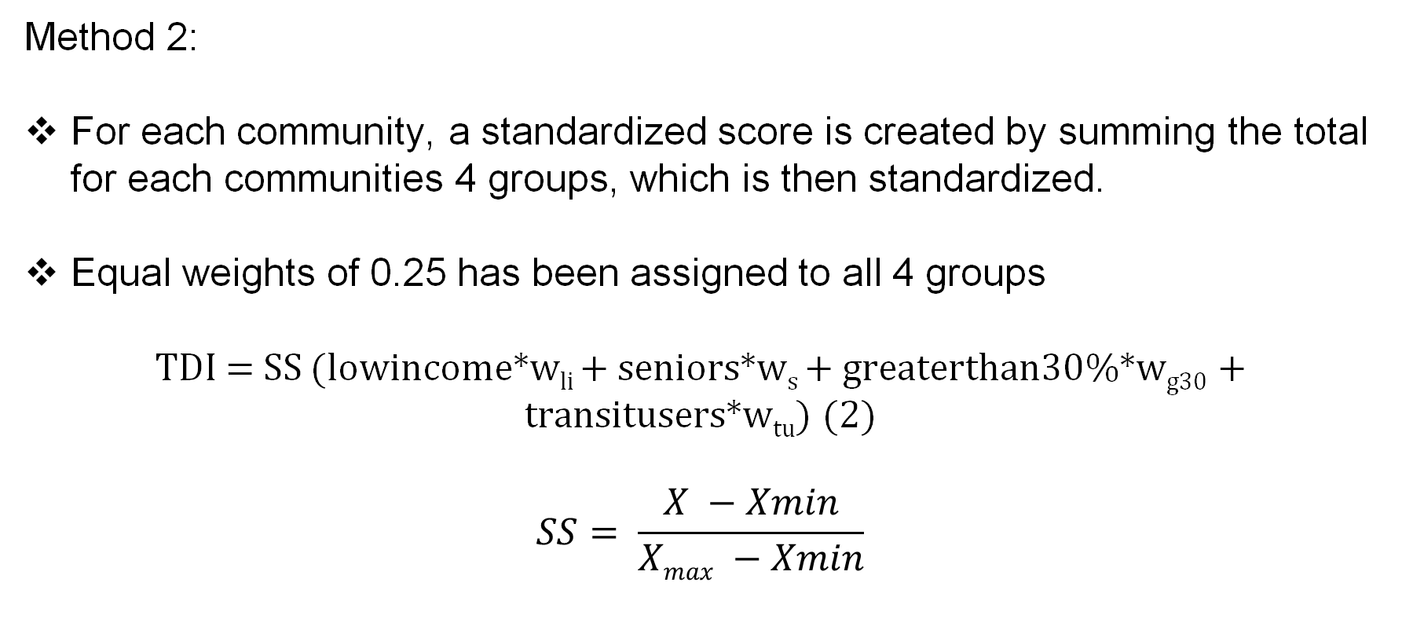
Demand Index: Calculation (Method 2)
Method 2:
For each community, a standardized score is created by summing the total for each communities 4 groups, which is then standardized.
Equal weights of 0.25 has been assigned to all 4 groups
TDI = SS (lowincome*w_{li} + seniors*w_{s} + greaterthan30%*w_{g30} + transitusers*w_{tu}) (2)
$$SS= \frac{X −Xmin}{Xmax −Xmin}$$

Slide 18
Demand Index Table (Method 2)
Community | Demand Index | Letter Grade Score
Wolf Willow | 0.0000 | F
Belmont | 0.0020 | F
Scarborough-Sunalta West | 0.0037 | F
Eagle Ridge | 0.0045 | F
Mayfair | 0.0049 | F
Hillhurst | 0.4389 | A
Panorama Hills | 0.4441 | A
Varsity | 0.4462 | A
Downtown Commercial Core | 0.4663 | A
Beltline | 1.0000 | A
The 200 communities are split into 5 quantiles and assigned letter grades accordingly

Slide 19
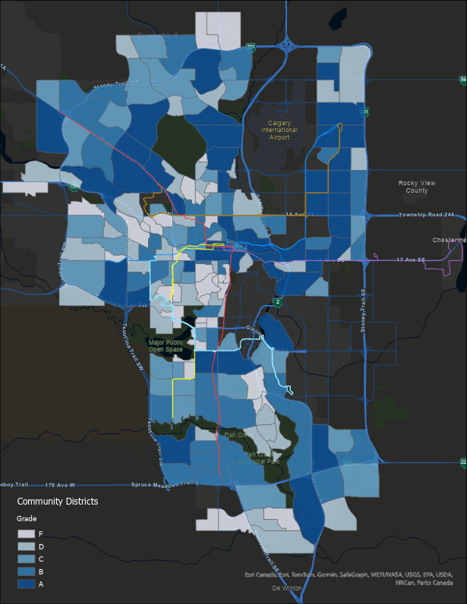
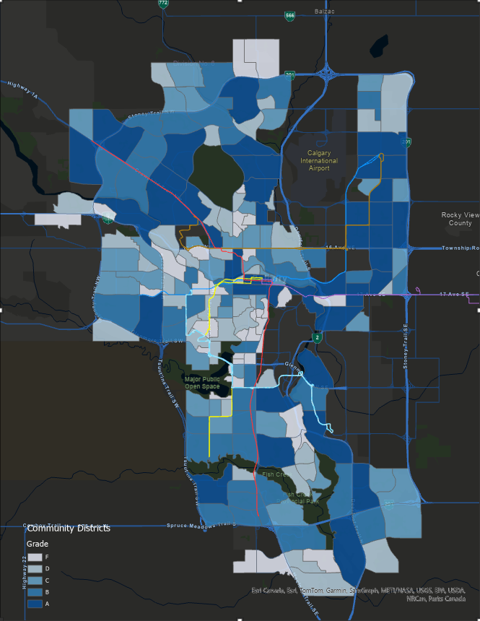
Demand Index 1
Demand Index 2

Slide 20
04
Supply Index

Slide 21
Supply Index Calculation
Recall the components of the LITA: Service frequency, service coverage, and service capacity.
Scores are calculated for each component and are standardized across the components.
The LITA score for each community is then the average of the three standardized scores.
$$TSI=\frac{SS(Zservicefreq+Zservicecov+Zservicecap) }{3}$$

Slide 22
Supply Index Table: Current Primary Transit Network
Community | Supply Index | Letter Grade Score
94 Communities | 0.0000 | F
Montgomery | 0.0088 | D
Royal Oak | 0.0123 | D
Pineridge | 0.0279 | D
Downtown East Village | 0.6777 | A
Haysboro | 0.6975 | A
Chinook Park | 0.7271 | A
Downtown West End | 0.7609 | A
Beltline | 0.8961 | A
Downtown Commercial Core | 1.0000 | A
The 200 communities are split into 5 quantiles and assigned letter grades accordingly

Slide 23
Supply Index Table: Future Primary Transit Network
Community | Supply Index | Letter Grade Score
53 Communities | 0.0000 | F
Hidden Valley | 0.0097 | D
Hamptons | 0.01195 | D
Edgemont | 0.0127 | D
Lincoln Park | 0.8237 | A
Hounsfield Heights/Briar Hill | 0.8294 | A
Tuxedo Park | 0.8557 | A
Downtown Commercial Core | 0.8806 | A
Beltline | 0.9348 | A
Chinook Park | 1.0000 | A
The 200 communities are split into 5 quantiles and assigned letter grades accordingly

Slide 24
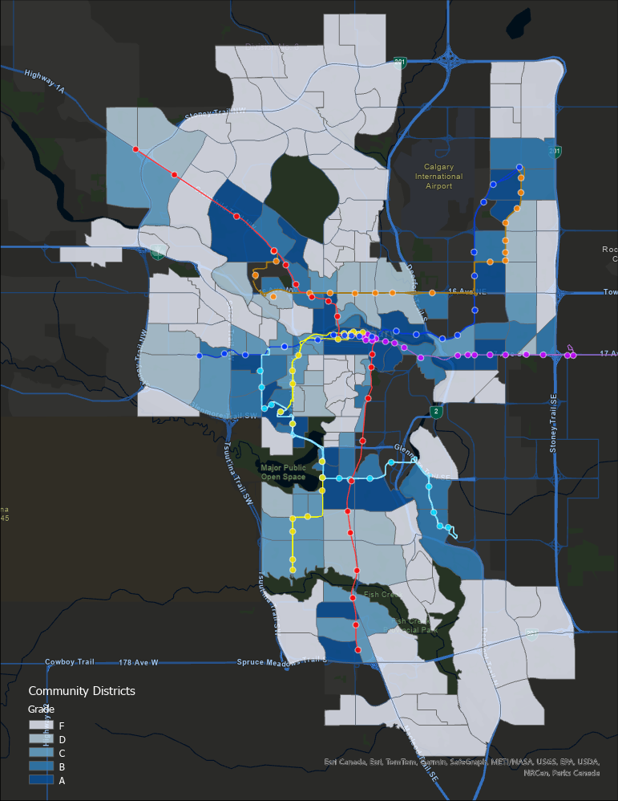
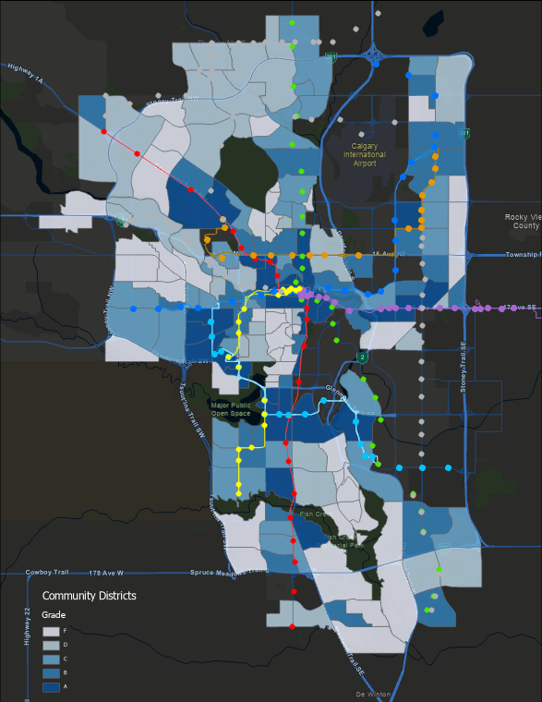
Current Supply Index
Future Supply Index

Slide 25
Transit Gap Analysis
05

Slide 26
Transit Gap Table (Demand Method 1): Current Primary Transit Network
Community | Demand - Supply | Letter Grade Score
Chinook Park | -0.5482 | A
Downtown West End | -0.3936 | A
Downtown Commercial Core | -0.3621 | A
Downtown East Village | -0.2667 | A
Haysboro | -0.2579 | A
Edgemont | 0.4179 | F
Bowness | 0.4254 | F
Dover | 0.4350 | F
Huntington Hills | 0.4628 | F
Panorama Hills | 0.4673 | F
The 200 communities are split into 5 quantiles and assigned letter grades accordingly

Slide 27
Transit Gap Table (Demand Method 1): Future Primary Transit Network
Community | Demand - Supply | Letter Grade Score
Chinook Park | -0.8211 | A
Hounsfield Heights/Briar Hill | -0.6207 | A
Lincoln Park | -0.5755 | A
Tuxedo Park | -0.5674 | A
Riverbend | -0.5346 | A
Bowness | 0.3807 | F
Panorama Hills | 0.4017 | F
Edgemont | 0.4052 | F
Evergreen | 0.4092 | F
Dover | 0.4351 | F
The 200 communities are split into 5 quantiles and assigned letter grades accordingly

Slide 28
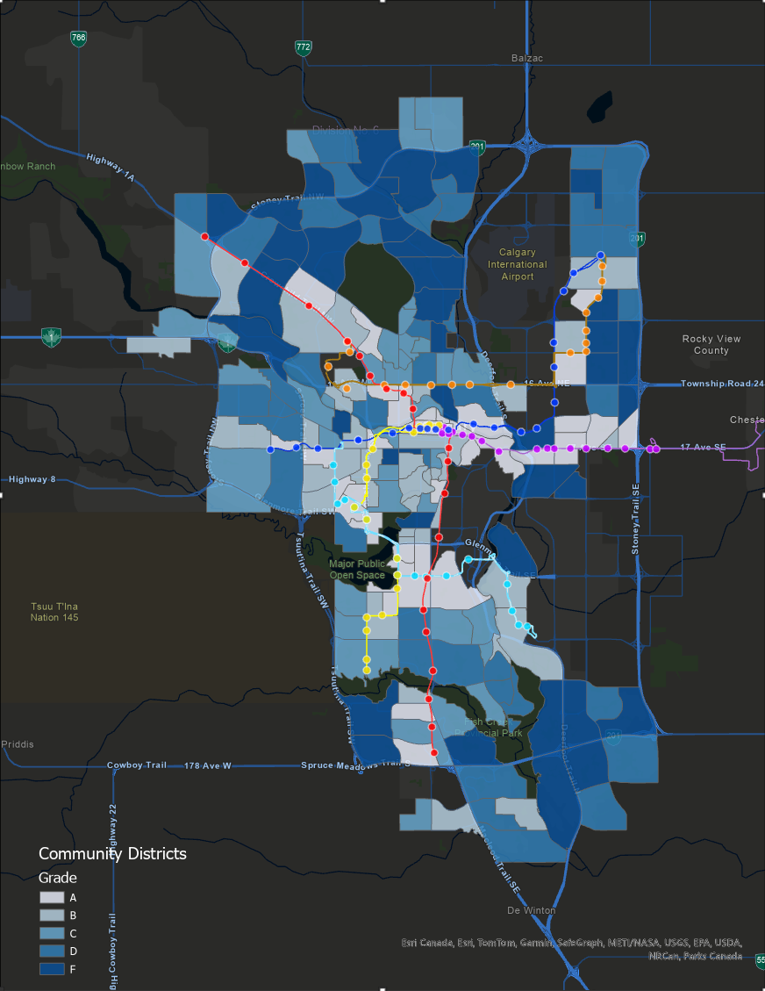
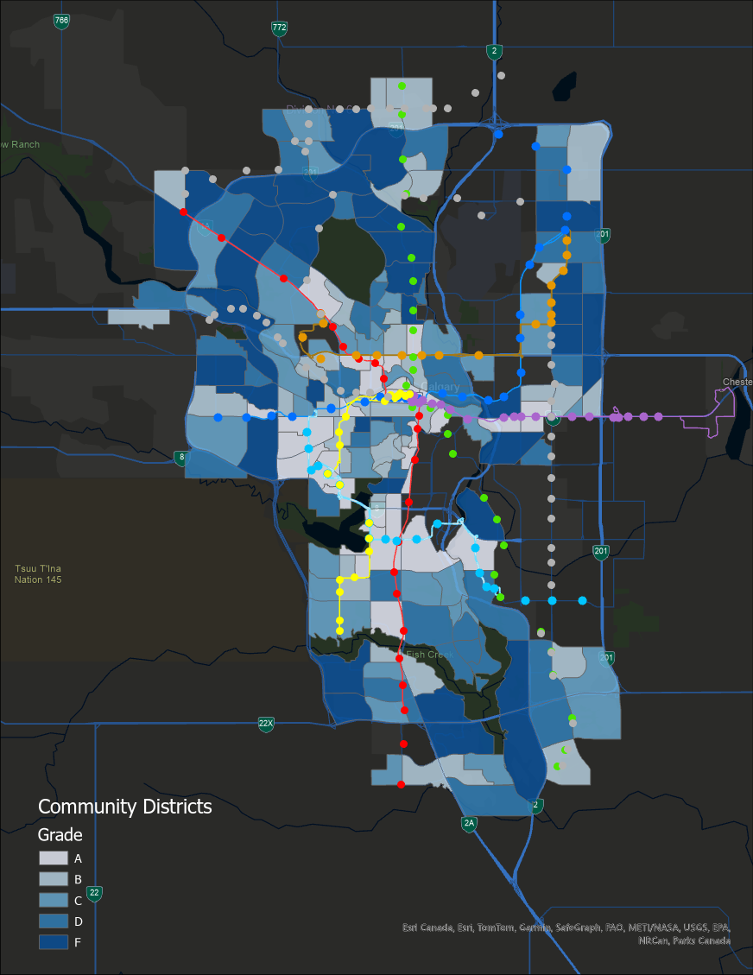
Current Gap 1
Future Gap 1

Slide 29
06
Way Forward

Slide 30
Final Goal Before Submission to Client
Reach Goal: Create a dashboard for different weights using method 2 demand index calculation
$100M
$20M

Slide 31
Transit Gap Table (Demand Method 2): Current Primary Transit Network
Community | Demand - Supply | Letter Grade Score
Chinook Park | -0.6854 | A
Downtown West End | -0.6547 | A
Downtown East Village | -0.5368 | A
Downtown Commercial Core | -0.5337 | A
Haysboro | -0.4740 | A
Highland Park | 0.3685 | F
Dover | 0.3769 | F
Huntington Hills | 0.4257 | F
Edgemont | 0.4307 | F
Panorama Hills | 0.4441 | F
The 200 communities are split into 5 quantiles and assigned letter grades accordingly

Slide 32
Transit Gap Table (Demand Method 2): Future Primary Transit Network
Community | Demand - Supply | Letter Grade Score
Chinook Park | -0.9583 | A
Hounsfield Heights/ Briar Hill | -0.7603 | A
Lincoln Park | -0.7439 | A
Tuxedo Park | -0.7108 | A
Riverbend | -0.6260 | A
Bowness | 0.3112 | F
Evergreen | 0.3544 | F
Dover | 0.3769 | F
Panorama Hills | 0.3785 | F
Edgemont | 0.4180 | F
The 200 communities are split into 5 quantiles and assigned letter grades accordingly

Slide 33
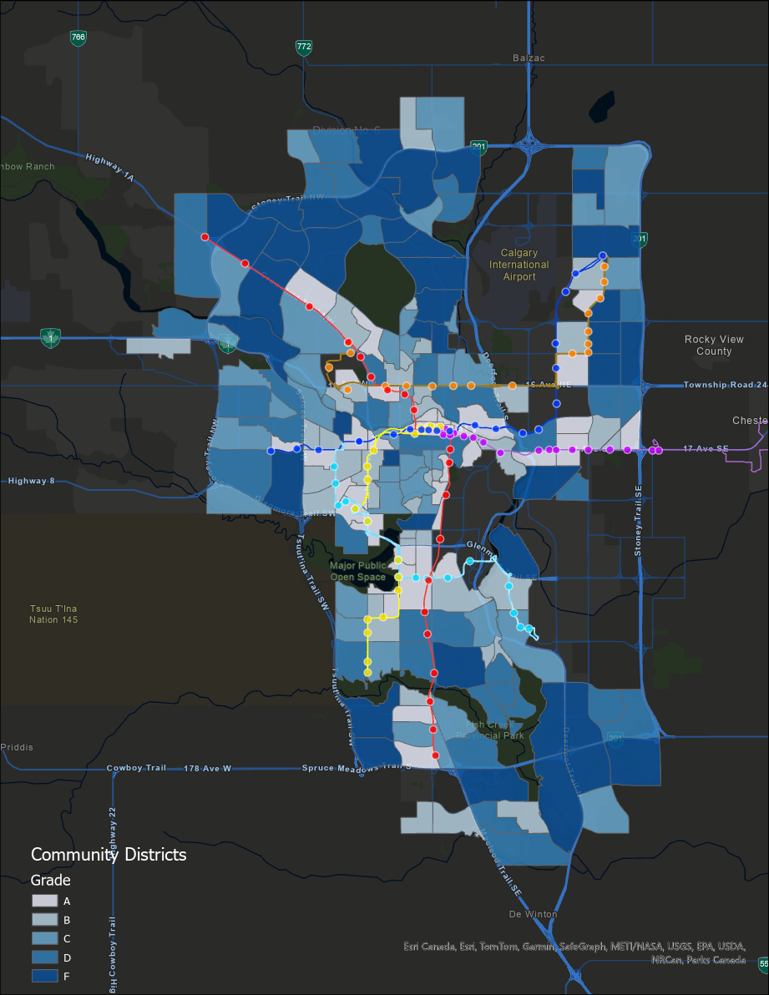
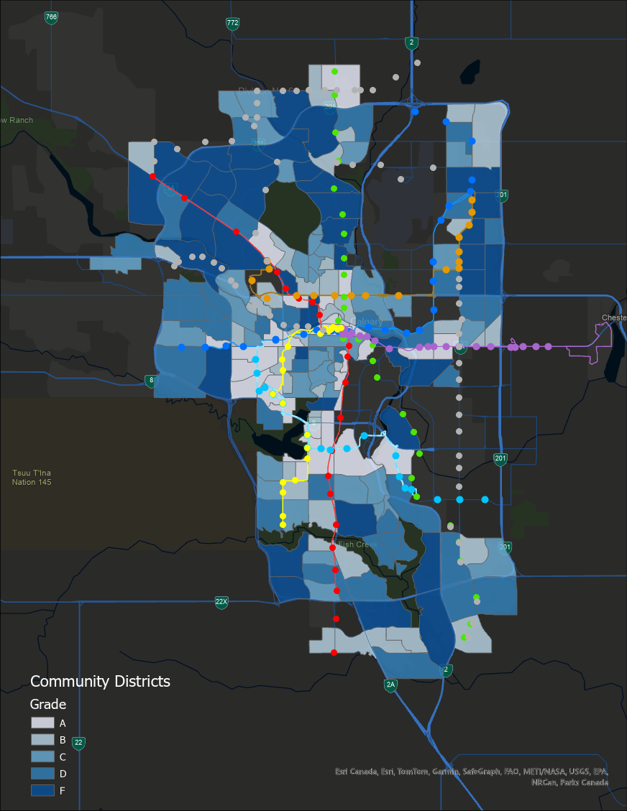
Current Gap 2
Future Gap 2

Slide 34
Thanks!
Do you have any questions?

